Slide 1
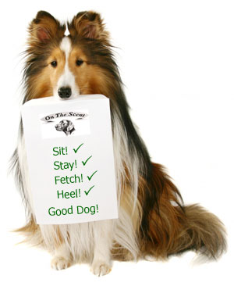

Dog Training 101
Presented By: Kaitlin Garrett
Notes:
Image size was reduced
Image source: http://mydoggiesdaycare.com/training.html

Slide 2
Table of Contents
What is dog training?
Why is training so important?
Tips to get started with training:
  Understanding pack instinct
  Timing
  Patience and repetition
  Socialization and exposure
  Punishment, training and interaction
Benefits of an obedient dog
Contact information

Slide 3
What is Dog Training?
Directing instincts already present in your dog
Promoting a happy and healthy relationship
Establishing good communication

Slide 4
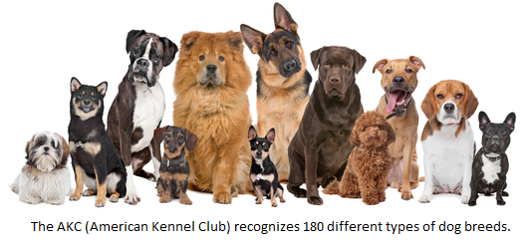
Why is Training so Important?
Satisfies need for attention and to please owner
Keeps mind active and reduce unwanted behavior
Important factor to keep dogs in their “forever” home
  Research breeds before you buy or adopt a dog
Notes:
Reduced image size and added caption as text overlay
Image source: http://www.talkourdogs.com/know-diverse-dog-breeds/

Slide 5
Tips to Get Started with Training
Understanding pack instinct
Timing
Patience and repetition
Socialization and exposure
Punishment, training and interaction

Slide 6
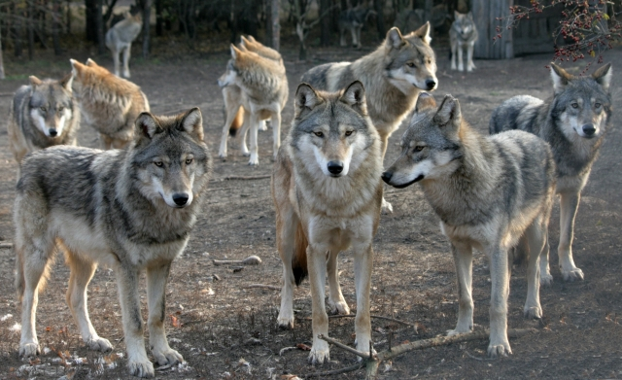
Understanding Pack Instinct
Dogs are instinctually social creatures
  Wolf ancestry and pack hierarchy
Roles of the pack leader
Encourage submission without abuse or punishment
Notes:
Reduced size of and cropped image
Image source: http://www.careeradvisordaily.com/lessons-from-the-wolf-pack-12-dealing-with-receptionists/

Slide 7
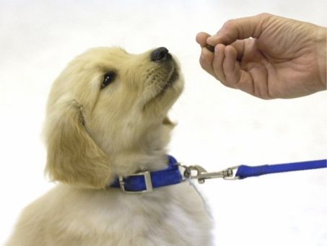
Timing
Crucial for command comprehension
Reward must be immediate
Notes:
Reduced image size and added black frame
Image source: http://www.raisingk9va.com/training-methods/

Slide 8
Patience and Repetition
Training is time consuming – be patient
Repetition to aid in retention
Avoid training routines
Training must be consistent

Slide 9
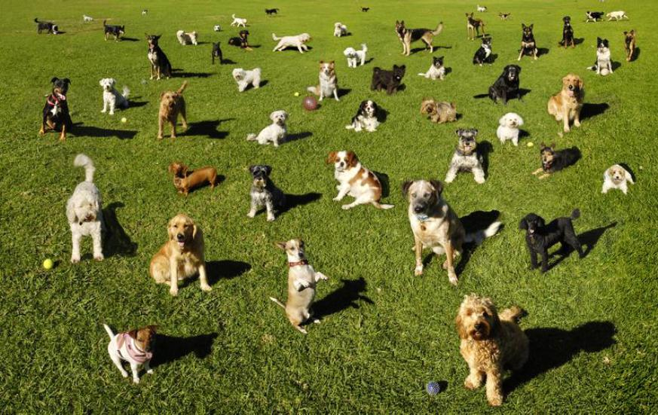
Socialization and Exposure
Socialize and expose to many different people, environments and noises
Conduct training in novel or busy environments
Notes:
Reduced size of image
Image source: http://best-dog-training-books.blogspot.com/

Slide 10
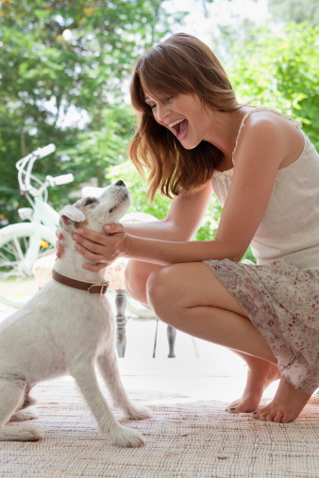
Punishment, Training and Interaction
Punishment should never include physical abuse
Training sessions should be fun and exciting
Interact and praise for desirable behaviors
Notes:
Reduced image size and cropped image
Image source: http://www.womansday.com/life/daily-buzz/new-study-reveals-the-best-way-to-praise-a-dog

Slide 11
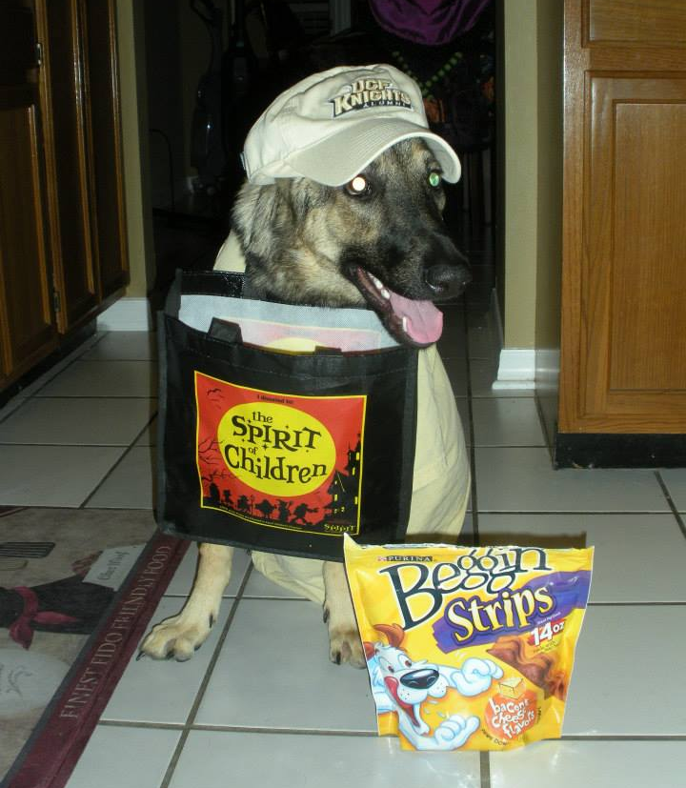
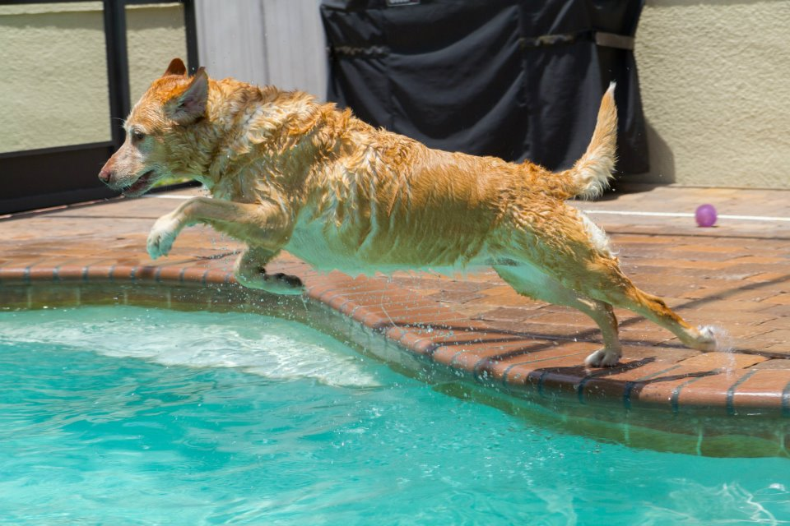
Benefits of an Obedient Dog
Being able to do the things you want to do
Avoid trouble with other people and dogs
Keeps your canine companion safe
Chloe swimming
Sadie trick-or-treating
Notes:
Developed images from scratch, cropped images and added captions
Image source: original images

Slide 12
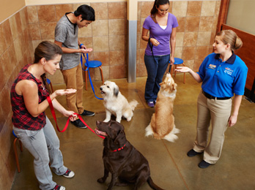
Contact Information
Contact Kaitlin Garrett with any questions.
Resources:
  PetSmart training classes
  Find a local trainer
Notes:
Reduced size of image
Image source: http://pets.petsmart.com/services/dog-training/classes/

